Slide 1
Acing 10 Marker

Slide 2
An IB question is like…
WAR

Slide 3
Acing the 10 Marker
“Getting on the boat”
If you don’t get on the boat, there is no way that you can fight the battle.
Or if you trip over on the boat, chances are you are going to be killed quickly.

Slide 4
Acing the 10 Marker
“Hit the Sand”
In war, if you don’t get on the beach and survive, then you simply die.
https://www.youtube.com/watch?v=GyvAY9rp_zU

Slide 5
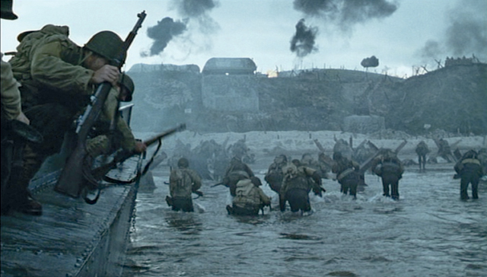
Acing the 10 Marker
“Hitting the Beach”

Slide 6
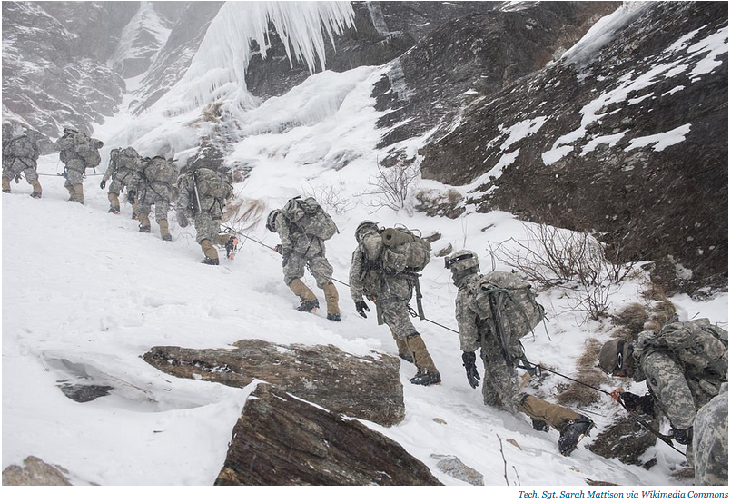
Acing the 10 marker
Climbing the Moutain

Slide 7
Acing the 10 marker
Take the cherry on top of the flag
Capture the Flag

Slide 8
Acing the 10 Marker
Explain why the price elasticities of the demand and supply curves are as important as the magnitude of the shifts of the curves in determining the final equilibrium quantity.
Introduction: You should define key terms
The equilibrium quantity is defined as traded quantity where demand and supply are equal and there is no tendency for this to change. This is determined by the price elasticity of the demand and supply curve which is defined as the their respective responsiveness to the change in price, and the magnitude of the shift which leads to a change in quantity demanded/supplied at each and every price level.
Get on the boat

Slide 9
Acing the 10 marker
P
S
P
P₂
S
P₃
P₁
P₁
D₂
D₁
D₂
D₁
0
Q₁
Q₂
0
Q₁
Q₃
Q
Q
Diagram 1
Diagram 2

Slide 10
Acing the 10 marker
A change in the change in demand involves a shift in both curves at each and every price level. For example an increase in the level of demand will shift the demand curve from D₁ to D₂, as shown in diagram 1 and 2 above.
In the presence of a supply curve, a rightward shift in the demand curve will lead to an increase in equilibrium price. According to the law of supply, quantity supplied will increase i.e. movement along the curve. However, the equilibrium quantity will be dependent on the PES of the supply curve which is reflected by the relative steepness of the supply curve. Suppose that that supply is very inelastic due to the factory operating at full capacity as shown by a steep supply curve in diagram 1, a large shift in the demand curve will only to a small increase in equilibrium quantity sold (Q₁ to Q₂)
Hitting the Sand
You should answer the question directly in the first paragraph and not waffle.
Climbing the Mountain

Slide 11
Acing the 10 marker
Use Examples to demonstrate you can apply economic theories to the real world
This is contrasted with a more price elastic supply curve, perhaps due to greater mobility in the factors of production e.g. easier to hire labourers, as shown by the shallower supply curve in diagram 2. The size of the shift in demand remains the same but the equilibrium is greater (Q₁ to Q₃) than diagram 1 (Q₁ to Q₂). Here the producer is able to be more responsive to an increase in price and more quantity will be supplied compared to diagram 1.
Climbing the Mountain
Capture the Flag
Diagram 1 and 2 has been compared to show that elasticity does make a difference

Slide 12
Acing the 10 Marker
It is interesting to note that the equilibrium price in diagram 1 (P₂) is greater than P₃ in diagram 2. As supply is price inelastic in diagram 1, perhaps due to limited production capacity, the disequilibrium caused by a large increase in demand can only be restored by a higher equilibrium price (P₂ > P₃)
Take the Cherry on top of the flag
This part is not compulsory but could be put in to show a good economic awareness. Do not write this unless you have captured the flag!
Showing good economic awareness here

Slide 13
Acing the 10 marker
Conclusion
From the above, it can be seen that the elasticity is as important as the magnitude of the shifts in curves in determining the equilibrium quantity. This is because the shifts in one curve e.g. demand will lead to a movement in the other curve e.g. supply and the final equilibrium will be a combination of the two forces.
Maximum two sentences. Don’t bring in new points here.

