Slide 1
NAME: ____________________________
This is your PERSONAL response booklet to the theme of bullying.
Everything you write in here will be CONFIDENTIAL.
A response is expected for every section.

Slide 2
1. What is bullying?
2. What does a bully look like?
3. What does a victim look like?

Slide 3
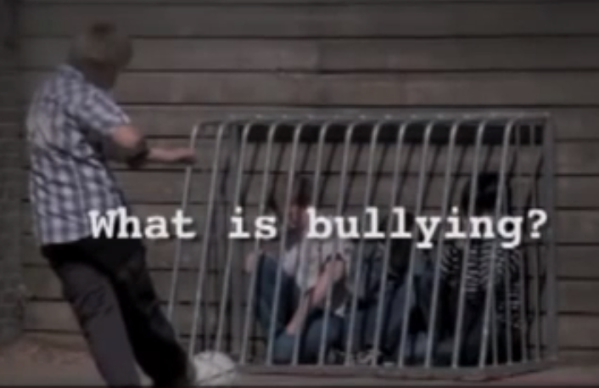
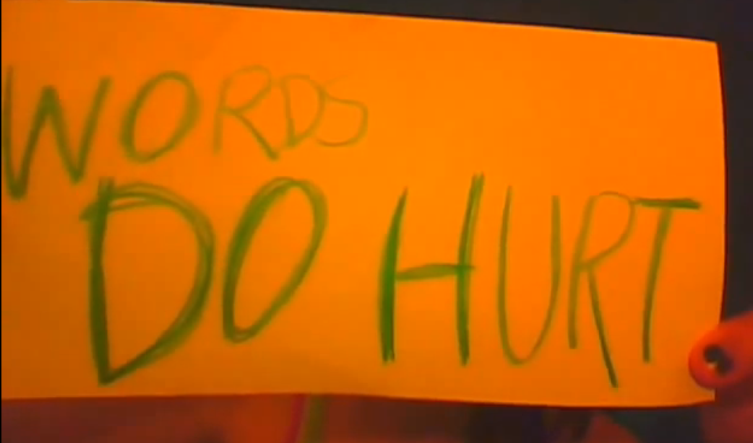
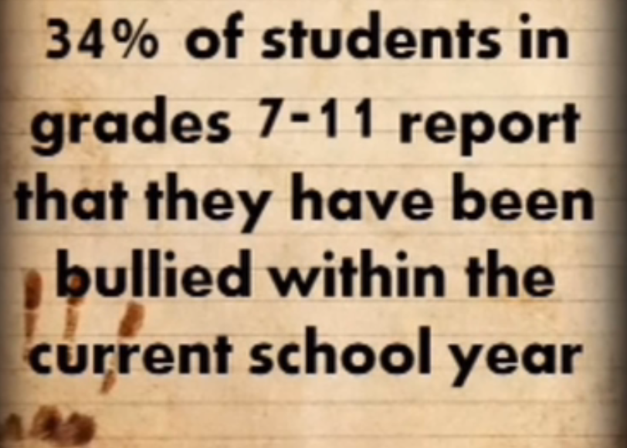
After watching the video ‘What is bullying?’,
How did the video make you feel? What surprised you the most?
After watching the video ‘Words do hurt’,
How did the video make you feel? What surprised you the most?
After watching the video ‘Bullied to death’,
How did the video make you feel? What surprised you the most?
Notes:
http://www.stopbullying.gov/videos/2010/09/what-is-bullying.html

Slide 4
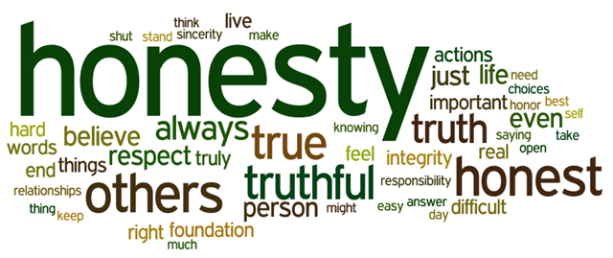
Describe a time when you were a victim of bullying, and include descriptions of your emotions:
………………………………………………………………………………………………………………………………………………………………………………………………………………………………………………………………………………………………………………………………………………………………………………………………………………………………………………………………………………………………………………………………………………………………………………………………………………………………………………………………………………………………………………………………………………………………………………………………………………………………………………………………………………………………………………………………………………………………………………………………………………………………………………………………………………………………………………………………………………………………………………………………………………………………………………………………………………………………………………………………………………………………………………………………………………………………………………………………………………………………………………………………………………………………………………………………………………………………………………………………………………………………………………………………………………………………………………………………………………………………………………………………………………………………………………………………………………………………………………………………………………………………………………………………………………………………………………………………………………………………………………………………………………………………………………………………………………………………………………………………………………………………………………………………………………………………………………………………………………………………………………………………………………………………………………………………………………………………………………………………………………………………………………………………………………………………………………………………………………………………………………………………………………………………………………
………………………………………………………………………………………………………………

Slide 5
Describe a time when you were a bully, and include descriptions of your emotions:
………………………………………………………………………………………………………………………………………………………………………………………………………………………………………………………………………………………………………………………………………………………………………………………………………………………………………………………………………………………………………………………………………………………………………………………………………………………………………………………………………………………………………………………………………………………………………………………………………………………………………………………………………………………………………………………………………………………………………………………………………………………………………………………………………………………………………………………………………………………………………………………………………………………………………………………………………………………………………………………………………………………………………………………………………………………………………………………………………………………………………………………………………………………………………………………………………………………………………………………………………………………………………………………………………………………………………………………………………………………………………………………………………………………………………………………………………………………………………………………………………………………………………………………………………………………………………………………………………………………………………………………………………………………………………………………………………………………………………………………………………………………………………………………………………………………………………………………………………………………………………………………………………………………………………………………………………………………………………………………………………………………………………………………………………………………………………………………………………………………………………………………………………………………………………………
………………………………………………………………………………………………………………

Slide 6
Describe a time when you could have done something to stop bullying, and include descriptions of your emotions:
………………………………………………………………………………………………………………………………………………………………………………………………………………………………………………………………………………………………………………………………………………………………………………………………………………………………………………………………………………………………………………………………………………………………………………………………………………………………………………………………………………………………………………………………………………………………………………………………………………………………………………………………………………………………………………………………………………………………………………………………………………………………………………………………………………………………………………………………………………………………………………………………………………………………………………………………………………………………………………………………………………………………………………………………………………………………………………………………………………………………………………………………………………………………………………………………………………………………………………………………………………………………………………………………………………………………………………………………………………………………………………………………………………………………………………………………………………………………………………………………………………………………………………………………………………………………………………………………………………………………………………………………………………………………………………………………………………………………………………………………………………………………………………………………………………………………………………………………………………………………………………………………………………………………………………………………………………………………………………………………………………………………………………………………………………………………………………………………………………………………………………………………………………………………………………
………………………………………………………………………………………………………………

Slide 7
POSITIVE ACTION – STAMP OUT BULLYING!
Describe what you are going to do from now on when you witness bullying:
………………………………………………………………………………………………………………………………………………………………………………………………………………………………………………………………………………………………………………………………………………………………………………………………………………………………………………………………………………………………………………………………………………………………………………………………………………………………………………………………………………………………………………………………………………………………………………………………………………………………………………………………………………………………………………………………………………………………………………………………………………………………………………………………………………………………………………………………………………………………………………………………………………………………………………………………………………………………………………………………………………………………………………………………………………………………………………………………………………………………………………………………………………………………………………………………………………………………………………………………………………………………………………………………………………………………………………………………………………………………………………………………………………………………………………………………………………………………………………………………………………………………………………………………………………………………………………………………………………………………………………………………………………………………………………………………………………………………………………………………………………………………………………………………………………………………………………………………………………………………………………………………………………………………………………………………………………………………………………………………………………………………………………………………………………………………………………………………………………………………………………………………………………………………………………
………………………………………………………………………………………………………………

