Slide 1
Are all clouds the same?
Using the pictures for inspiration create a ‘word wall’
in your books. Write down any words you can think
of that are connected to clouds

Slide 2
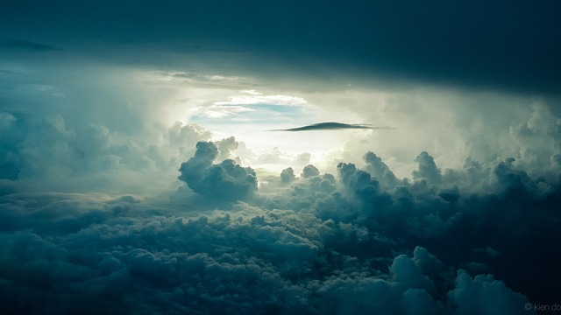

Slide 3
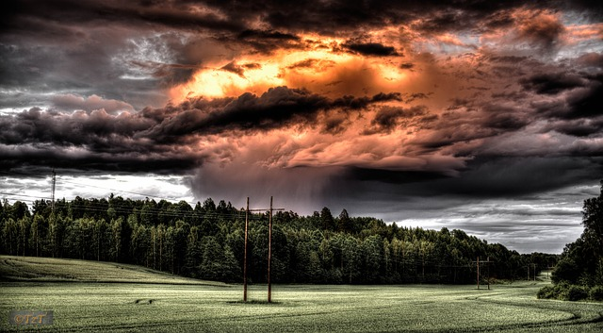

Slide 4
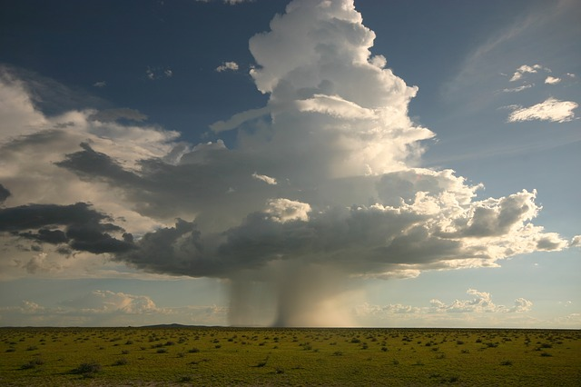

Slide 5
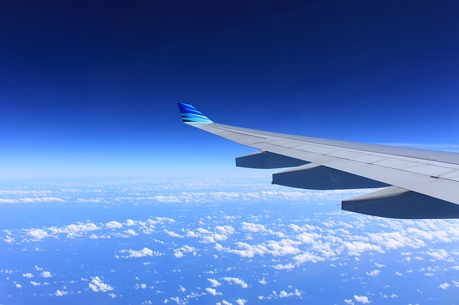

Slide 6
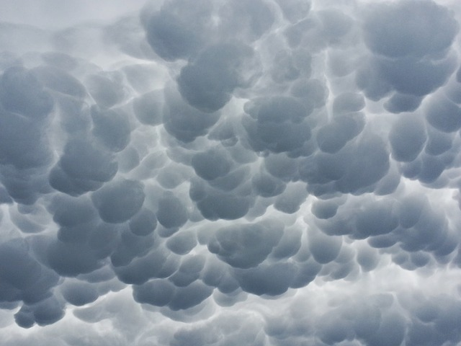

Slide 7
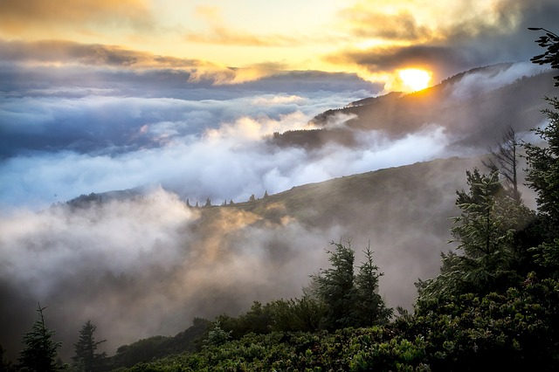

Slide 8
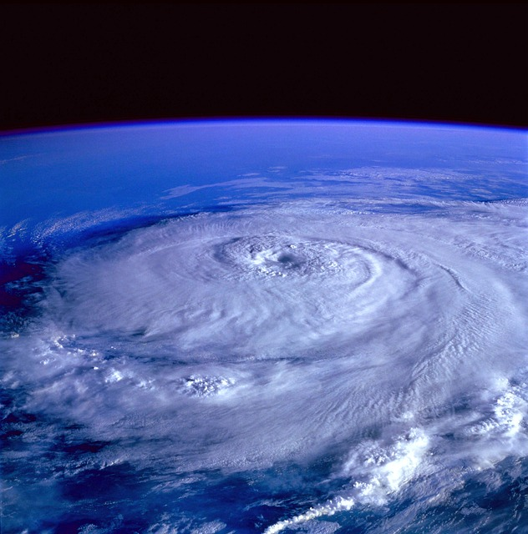

Slide 9
How do clouds form?
When there are clouds
is there always rain?
Why do clouds drop their rain?
Where does all of the
water come from?

Slide 10
Where does all
of the water
come from?

Slide 11
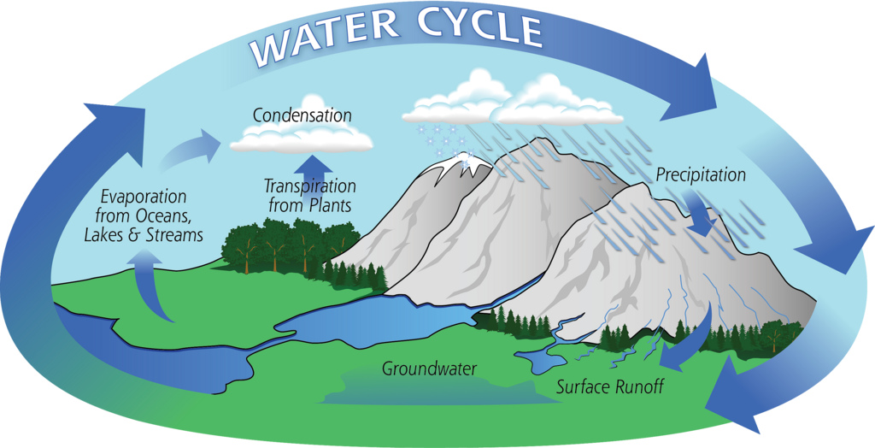

Slide 12
Draw your own
copy of the water
cycle with as much
detail as possible

Slide 14
But…..
What makes
it rain?

Slide 15
Produce an A4
information sheet
about the major types of cloud

Slide 17
My Favourite place is ……………………………..
I like this place because…………………………………………….......
……………………………………………………………………………………
My Favourite place is ……………………………..
I like this place because…………………………………………….......
……………………………………………………………………………………
My Favourite place is ……………………………..
I like this place because…………………………………………….......
……………………………………………………………………………………
My Favourite place is ……………………………..
I like this place because…………………………………………….......
……………………………………………………………………………………
My Favourite place is ……………………………..
I like this place because…………………………………………….......
……………………………………………………………………………………
My Favourite place is ……………………………..
I like this place because…………………………………………….......
……………………………………………………………………………………

