Slide 1
IB Economics
An Introduction
Mr. Jeremy Lai

Slide 2
What words come to mind when you think of the word “Economics”?

Slide 3
Economics
Economics is a social science that studies how individuals, governments, firms and nations make choices on allocating scarce resources to satisfy their unlimited wants. (Investopedia)
Which are the 4 most important words in this definition?

Slide 4
3 basic economic questions
Scarcity of resources leads to the following questions being asked:
What to produce?
How to produce?
For whom to produce?

Slide 5
Resource allocation
These first two questions refers to assigning the available resources to the chosen goods being produced.
What to Produce?
When you choose to produce planes, you are making a conscious decision or choice to allocate resources to making planes
How to Produce?
In what ways/combinations should I use my resources to produce goods and services.

Slide 6
Distribution of Output & ????
For whom to Produce?
To whom should these products go to?
What system determines who gets what?
Should some products be distributed more equally?
What else do you think this is related to the distribution of ?

Slide 7
Question
What must follow whenever I make an economic choice?
OPPORTUNITY COST
Highest value forgone!

Slide 8
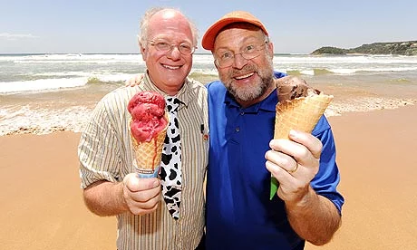
At Ben and Jerry’s, you have to choose between Vanilla and Chocolate.
When you choose Vanilla, the opportunity cost is the enjoyment of Chocolate.
A business owns a truck. If the company does not use the truck, it could be rented to someone else.
The opportunity cost of staying there is the amount of rent the company would get.

Slide 9
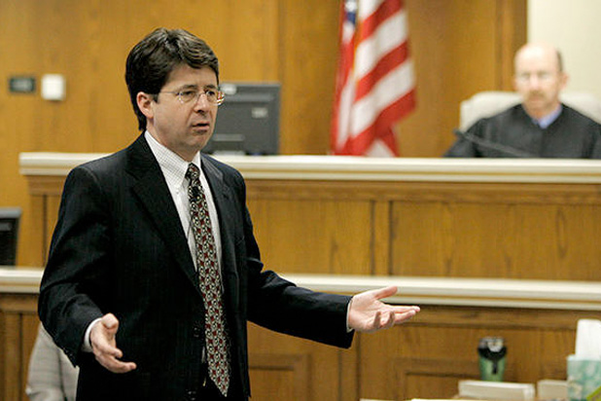
As a lawyer, you get $1000 an hour. Instead of working one night, you go to a concert that costs $25 and lasts two hours.
The opportunity cost of the concert is $2000 for two hours of work.

Slide 10
What is YOUR opportunity cost of being in my lesson?
What is MY opportunity cost of teaching this lesson?

Slide 11
Mr. Brown makes $400 an hour as an banker and is considering paying someone $1000 to paint his house. If he decides to do it himself, it will take four hours. He decides to do it himself and incurs opportunity cost of___________?
$1600
Why is this answer strange?

Slide 12
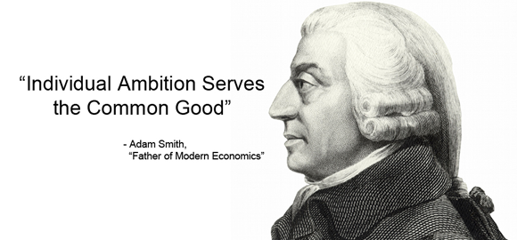
Rational economic decision making
An assumption that people will act in their best self-interest, trying to maximise the satisfaction they affect to receive from their economic decisions.
This is an important assumption because under the current economic system, people acting in their self interest will lead to the best interest of society.
Notes:
Why does this assumption hold in economics?

Slide 13
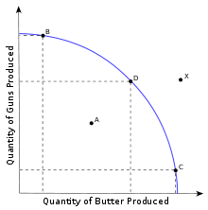
Production Possibilities Curve
“Condition of Scarcity”…
All resources must be fully utilised. If not fully utilised, more of the goods can be produced.
Productive efficiency is achieved. Resources are used in the best possible way to avoid waste. Alternatively, the products are produced at the least possible cost
Notes:
What is this curve showing you?
What does this graph show?
What is x? Condition of Scarcity does not allow economy to produce outside PPC
What is A?
From a resource allocation perspective, what is happening at B, D and C.
Have students start sentence with “Condition of Scarcity” would mean that? (No model answers).
Condition of scarcity forces economy to make a choices about what particular combination of goods it wishes to produce.
7.What do you notice as you increased the number of butter produced…in other words, moving from B to D to C? (Ans: the number of guns would reduce)

Slide 14
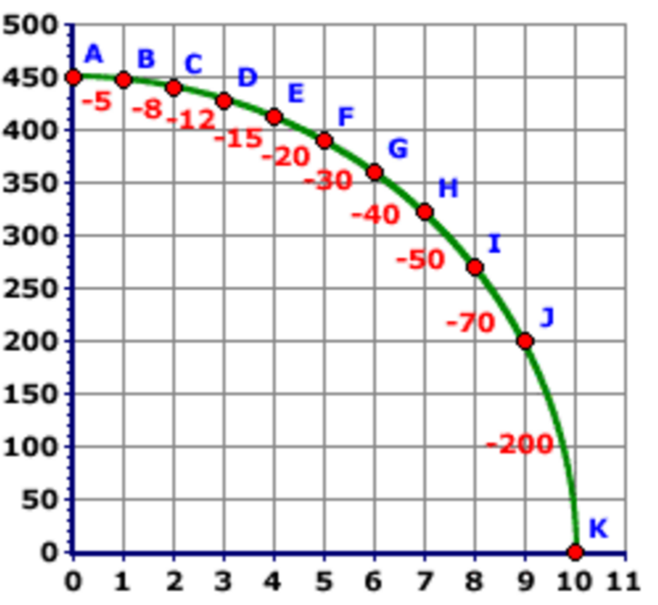
Production Possibilities Curve (2)
Burgers
Cars
Notes:
1) Economically, what is represented by the gradient of the curve? Condition of scarcity forces economy to make a choices about what particular combination of goods it wishes to produce. The condition of choices means that choices involve opportunity cost.
2) Come up with your definition of the productive possibility curve

Slide 15
Production Possibilities Curve
The PPC represents all combinations of the maximum amounts of two goods that can be produced by an economy given its resources and technology, when there is full employment of resources and productive efficiency.
The condition of scarcity does not allow the economy to produce outside its PPC
The condition of scarcity forces the economy to make a choice about what particular combination of goods it wishes to produce
The condition of scarcity means that choices involve opportunity costs.
Notes:
Give them one minute to look over this slide

Slide 16
Positive vs. Normative Economics
Positive statements are objective statements that can be tested, amended or rejected by referring to the available evidence.
A rise in average temperatures will increase the demand for sun screen products.
Normative statements are subjective statements of opinion rather than a fact that can be tested by looking at the available evidence
VSA students should treat their economics teacher to lunch everyday.

Slide 17
Positive or Normative?
It is raining today
It is too humid today
Economics is a study of choices
Economics should be concerned with how to reduce poverty
Households save too little of their income

Slide 18
Microeconomics & Macroeconomics
Microeconomics examines the behavior of individual decision making units in the economy. The two main groups of decision makers are consumer and firms.
Macro economics examines the economy as a whole, to contain a broad or overall picture by use of aggregates which are wholes or collections of many individual units such as the sum of consumption behaviours.

Slide 20
Using your textbooks, especially the contents page, draw a diagram showing how the discipline of economics fits together.

Slide 21
Where does Economics fit in?
Science
Social Science
Humanities
Arts

