Slide 1
Simple Accounting

Slide 2
Accounting is the language of business

Slide 3
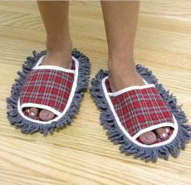
Simple accounting
The aim for an Entrepreneur is to earn PROFIT
Profit = Revenue – Cost
Revenue = Price x Quantity sold
Cost = Cost per unit x Quantity made
Let’s use the shoe mop product as an example

Slide 4
Cost
A business has many different types of Cost but the cost could be divided into fixed cost and variable cost.
Fixed Cost
Fixed costs are costs which do not change when the quantity of products produced increases. This might be rent, lighting or even salaries for workers.
Variable Cost
Variable costs are costs which changes when the production increases. In our example, this would be the shoe materials, the lacing on the side and the mop at the bottom.

Slide 5
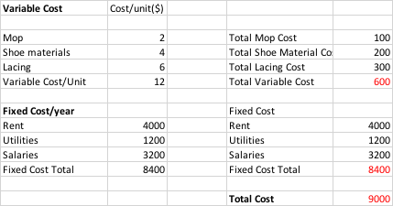
Suppose 50 are SOLD, what’s the cost?

Slide 6
Suppose 50 are SOLD, what’s the Revenue?
Assume the following
Price = $150
Quantity Sold = 50
Revenue = $7500

Slide 7
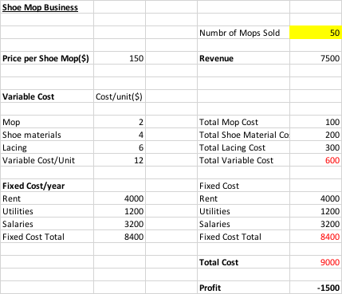
What is the profit/year?
How can I make this business more profitable?
Increase Revenue
Reduce Cost

